Slide 1







Rethinking Process Management for Interactive Mobile Systems
Jianwei Zheng, Zhenhua Li, Feng Qian, Wei Liu , Hao Lin
Yunhao Liu, Tianyin Xu, Nan Zhang, Ju Wang, Cang Zhang
Notes:
Hello, everyone!
I’m Wei Liu and I’m here to share our experiences in understanding and addressing the issue of slow UI responsiveness for interactive mobile systems.
This is a joint work with Tsinghua University, Xiaomi Technology, University of Southern California, and UIUC.

Slide 2
Outline
1. Background
2. Measurement
3. Key Findings
4. Solutions
5. Summary
Notes:
Here is the outline of my presentation.
Let me first introduce the background and the problem we face.

Slide 3

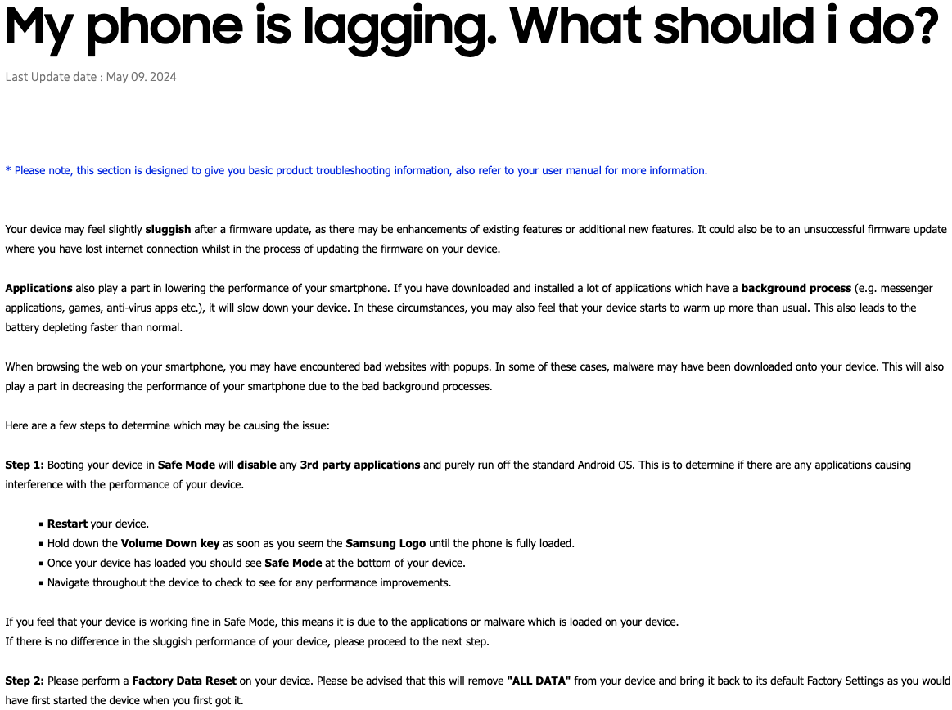
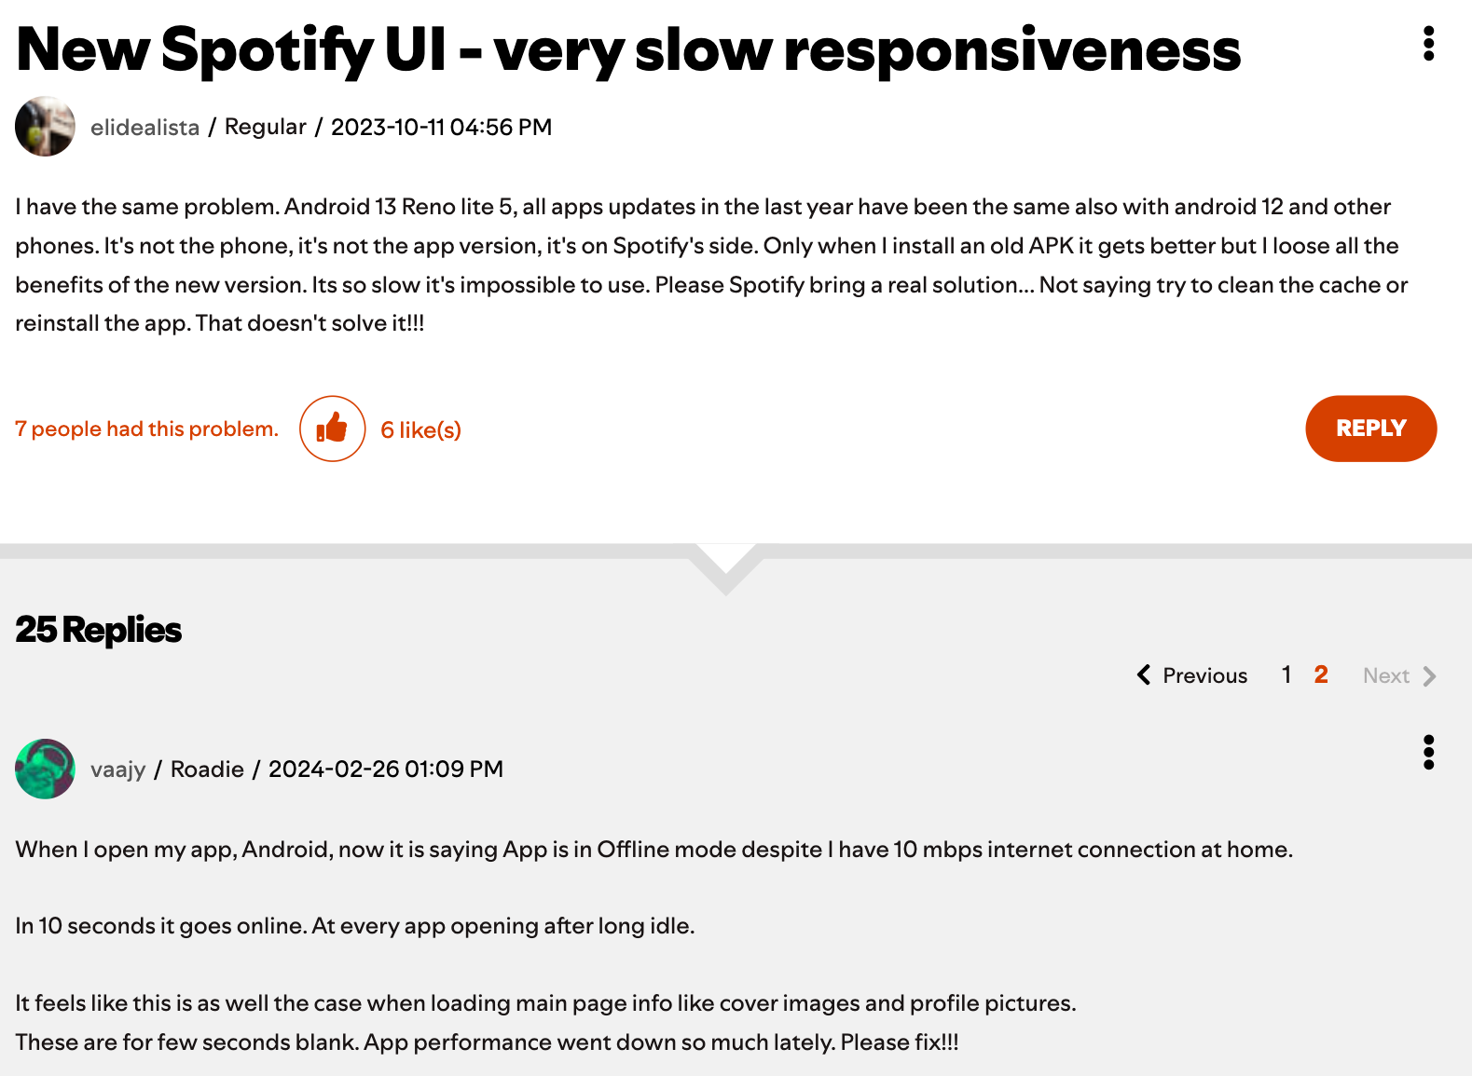
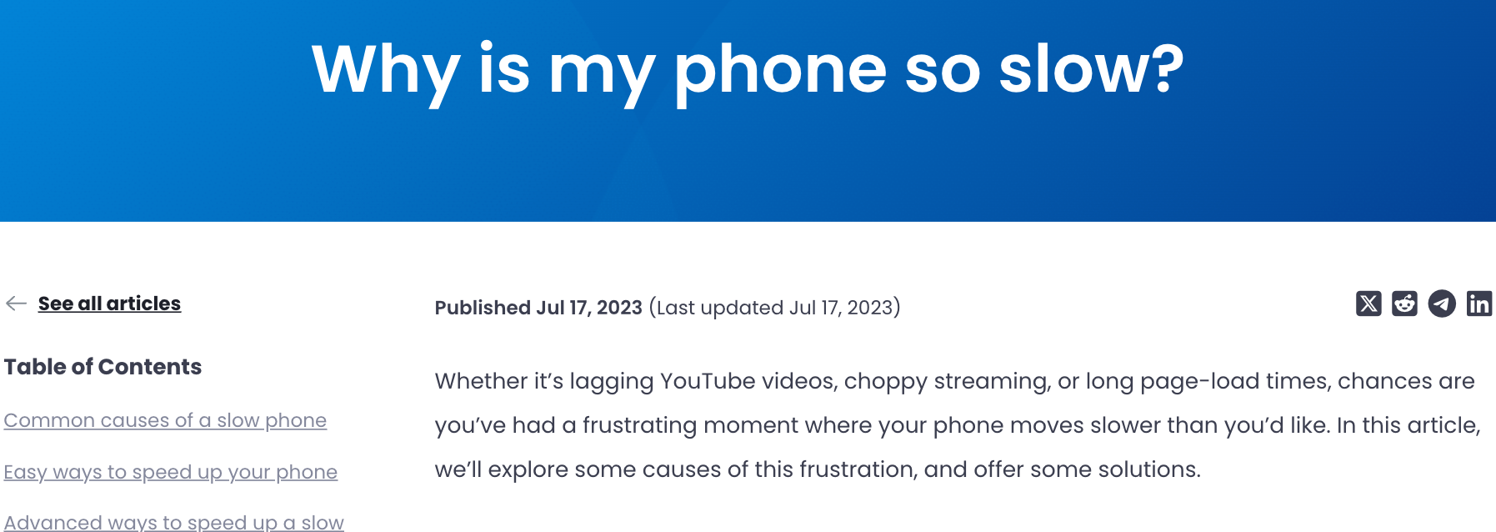
1. Slow UI Responsiveness
Interactive Mobile Systems support emerging highly interactive apps, e.g., AR/VR/MR, 3D games, and metaverse
Responsiveness: a key metric to measure the quality of user experience
Till now slow UI responsiveness (SUR) on interactive mobile systems is still prevalent
Typical slow UI responsiveness
Notes:
Everyone agrees that our mobile phones should respond to our interactions as quickly as possible, especially for today’s interactive mobile systems that support emerging highly interactive apps like AR, VR, and 3D games.
So, responsiveness is a key metric to measure the QoE of mobile phones.
However, till now mobile users still frequently encounter slow UI responsiveness (or SUR for short).
In the right side of the screen, we show a typical SUR, where we can see obvious frame drops when launching the Chrome app.

Slide 4
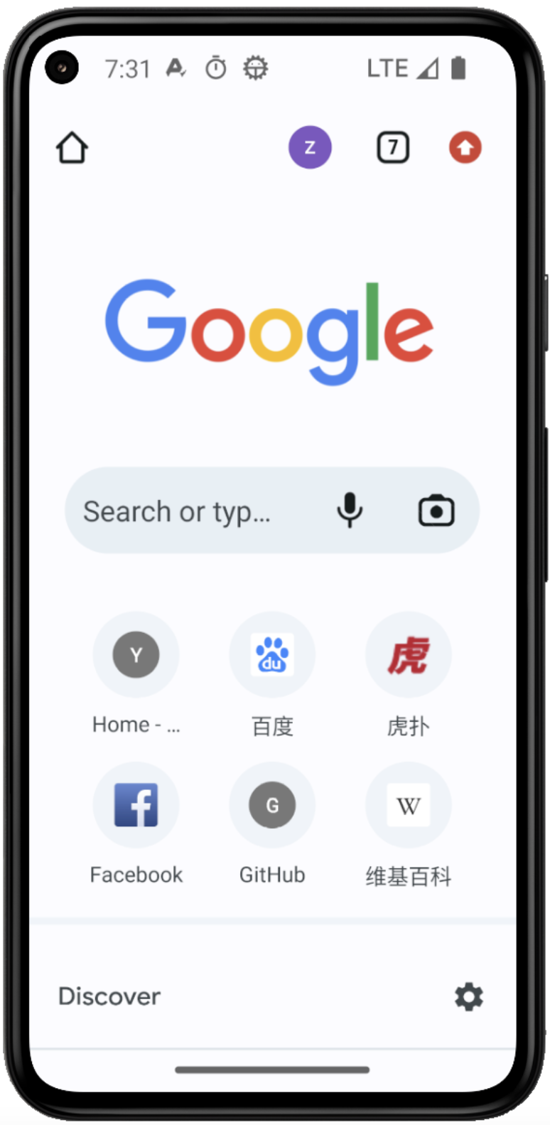

2. Frame Rendering Pipeline of Android
From touches to UI frames
Sophisticated——
any inefficiencies in each component/stage can slow down frame generation！
Input Event Dispatch
Hardware
Display
UI Thread Processing
RenderThread Execution
SurfaceFlinger
Composition
Notes:
Unfortunately, understanding SUR is not an easy job.
This is because today’s interactive mobile systems like Android usually have a complex frame rendering pipeline.
Any inefficiency in each stage of the pipeline can slow down frame rendering.
It involves at least five stages:
Input Event Dispatch, UI Thread Processing, RenderThread Execution, SurfaceFlinger, Composition, and Hardware Display.

Slide 5

2. Continuous Monitoring Infrastructure
Android’s original diagnostic mechanism is not enough
No formal definition of “perceptible” SUR events
Lacking insights into critical system services
Our continuous monitoring infrastructure
We collaborate with Xiaomi, a major phone vendor in China
Android-MOD: a customized Android system
Modifying vanilla Android versions 10.0, 11.0, and 12.0
Diagnosis w/ Android
Collecting info of critical system services
Android-MOD
  Lacking insights into critical system services
  Need to modify the Android framework
Notes:
Due to the complexity, some existing diagnostic tools and methods are not applicable for our in-depth understanding of SUR.
First, there is no formal definition of user-perceived SUR.
Second, we have very limited visibility into the critical system services that lead to SUR.
To address these challenges, we take a unique opportunity to collaborate with Xiaomi, which is the major phone vendor in China.
We develop a customized Android system, called Android-MOD, to collect the run-time information regarding SUR.

Slide 6
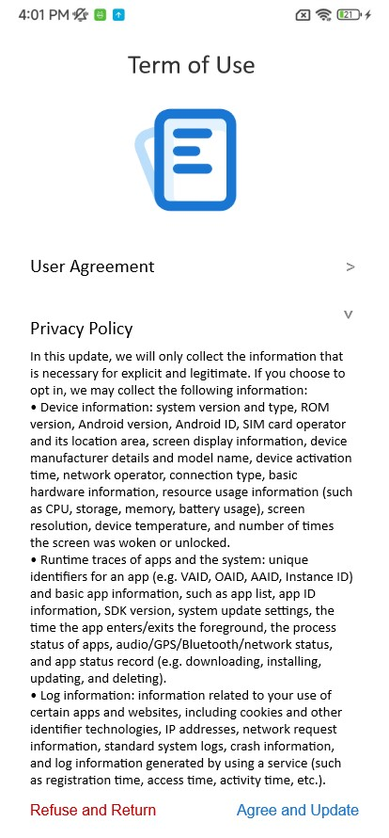
2. Continuous Monitoring Infrastructure
SUR definition: we did a user study by recruiting a variety of volunteers to identify perceptible SUR events (i.e., rendering delay > 50 ms)
System service instrumentation: we modify the code of critical system services to insert monitoring hooks, e.g., monitoring the lock contention
Cross-layer in-situ information tracing: e.g., CPU/memory/IO utilization
Lightweight: negligible runtime overhead
User-perceived times of consecutively dropped frames
User consent form
Notes:
Our continuous monitoring infrastructure addresses the aforementioned challenges.
We performed a user study to determine the user-perceived SUR.
We find that when two frames are dropped for a 60 Hz screen, more than 70% volunteers can perceive an SUR.
So we determine an SUR occurs when the rendering delay exceeds 50 milliseconds, that is the rendering time of three consecutive frames.
We also modify the system service to gather running information like lock contentions and resource utilizations.
The monitoring infrastructure is lightweight with negligible runtime overhead.
Note that every user participates in the study with an informed consent, and no personally identifiable information is collected.

Slide 7
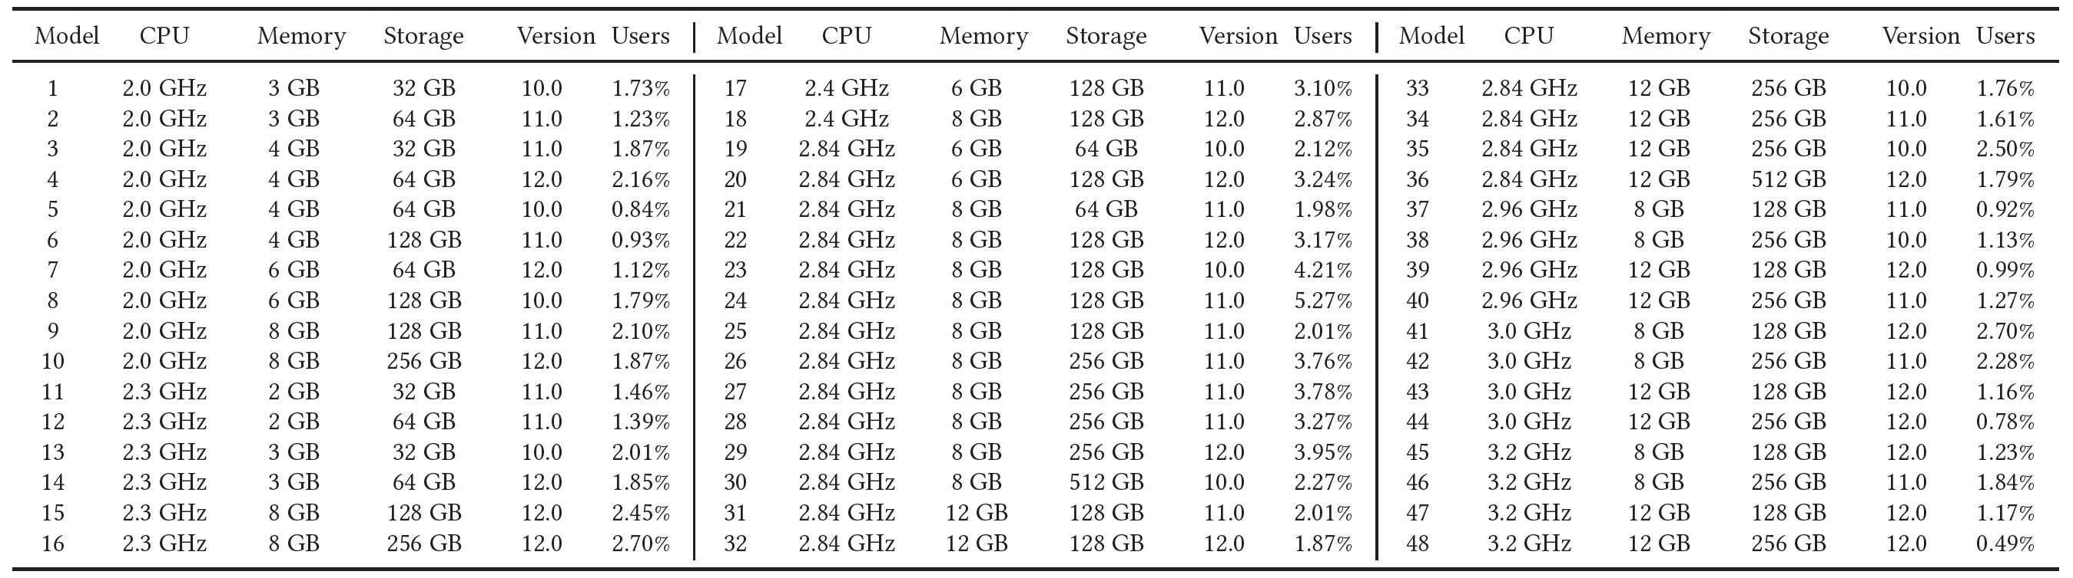
2. Crowdsourcing Measurement
We invited 500M Xiaomi users to participate, and 47M opted in
They upgraded the OS to Android-MOD to record SUR event data
The measurement lasted for four months (06-09/2022), involving a wide range of phones across 48 different models and 1M+ apps
Hardware and OS configurations of our measured phone models
Notes:
Eventually, over 47 million Xiaomi users opted in by upgrading their systems to Android-MOD.
Our measurement lasted for 4 months, covering a wide range of 48 different phone models and over one million Android apps.

Slide 8
3. Key Findings: Hardware
SUR events occur prevalently on all the 48 models per day (ranging from 80.42% to 97.73% with an average of 86.95%)
SUR events happen frequently on each specific model per day (ranging from 179.59 to 554.68 with an average of 338.28)
Better hardware cannot effectively reduce SUR events
Prevalence of SUR events on each model of phones
Frequency of SUR events on each model of phones
Notes:
Our measurement reveals that SUR events occur prevalently on all the studied 48 phone models.
Better hardware cannot effectively avoid SUR events.

Slide 9
3. Key Findings: Frame Drop Rate & OS
Frame drop rates of specific models are worryingly high: ranging from 3.09% to 14.12% with an average of 7.91%
Newer OS cannot effectively mitigate SUR events, owing to higher stability & robustness of older OSes (Android 10 and 11) and that Android 12 was still undergoing constant patches and required mobile apps to adapt to the newly-provided APIs
Frame drop rate of each phone model
SUR prevalence and frequency of each Android version
Notes:
From the OS perspective, newer Android version cannot effectively mitigate SUR events either.
This is because newer Oses are still undergoing constant patches and require mobile apps to adapt to new APIs.

Slide 10
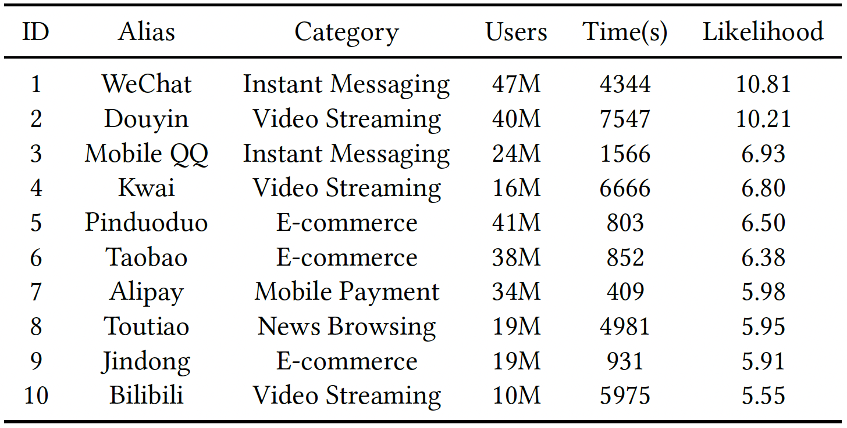
3. Key Findings: Mobile Apps
SUR event occurrences on different apps are skewed
16.8% SUR events are attributed to top-10 (<0.001%) apps
Heavy workloads incurred by high-resolution media streaming, embedded WebView browsers, and complex UI functionalities
Ranking of apps by their
number of SUR events per day
Top-10 apps ordered by the frequency (or simply
likelihood) of SUR events after normalization
Notes:
Also, from the perspective of mobile apps, we find that 16.8% SUR events are attributed to only the top-10 apps.
Apps with heavy workloads and complex UI functionalities are more likely to experience SUR events.

Slide 11

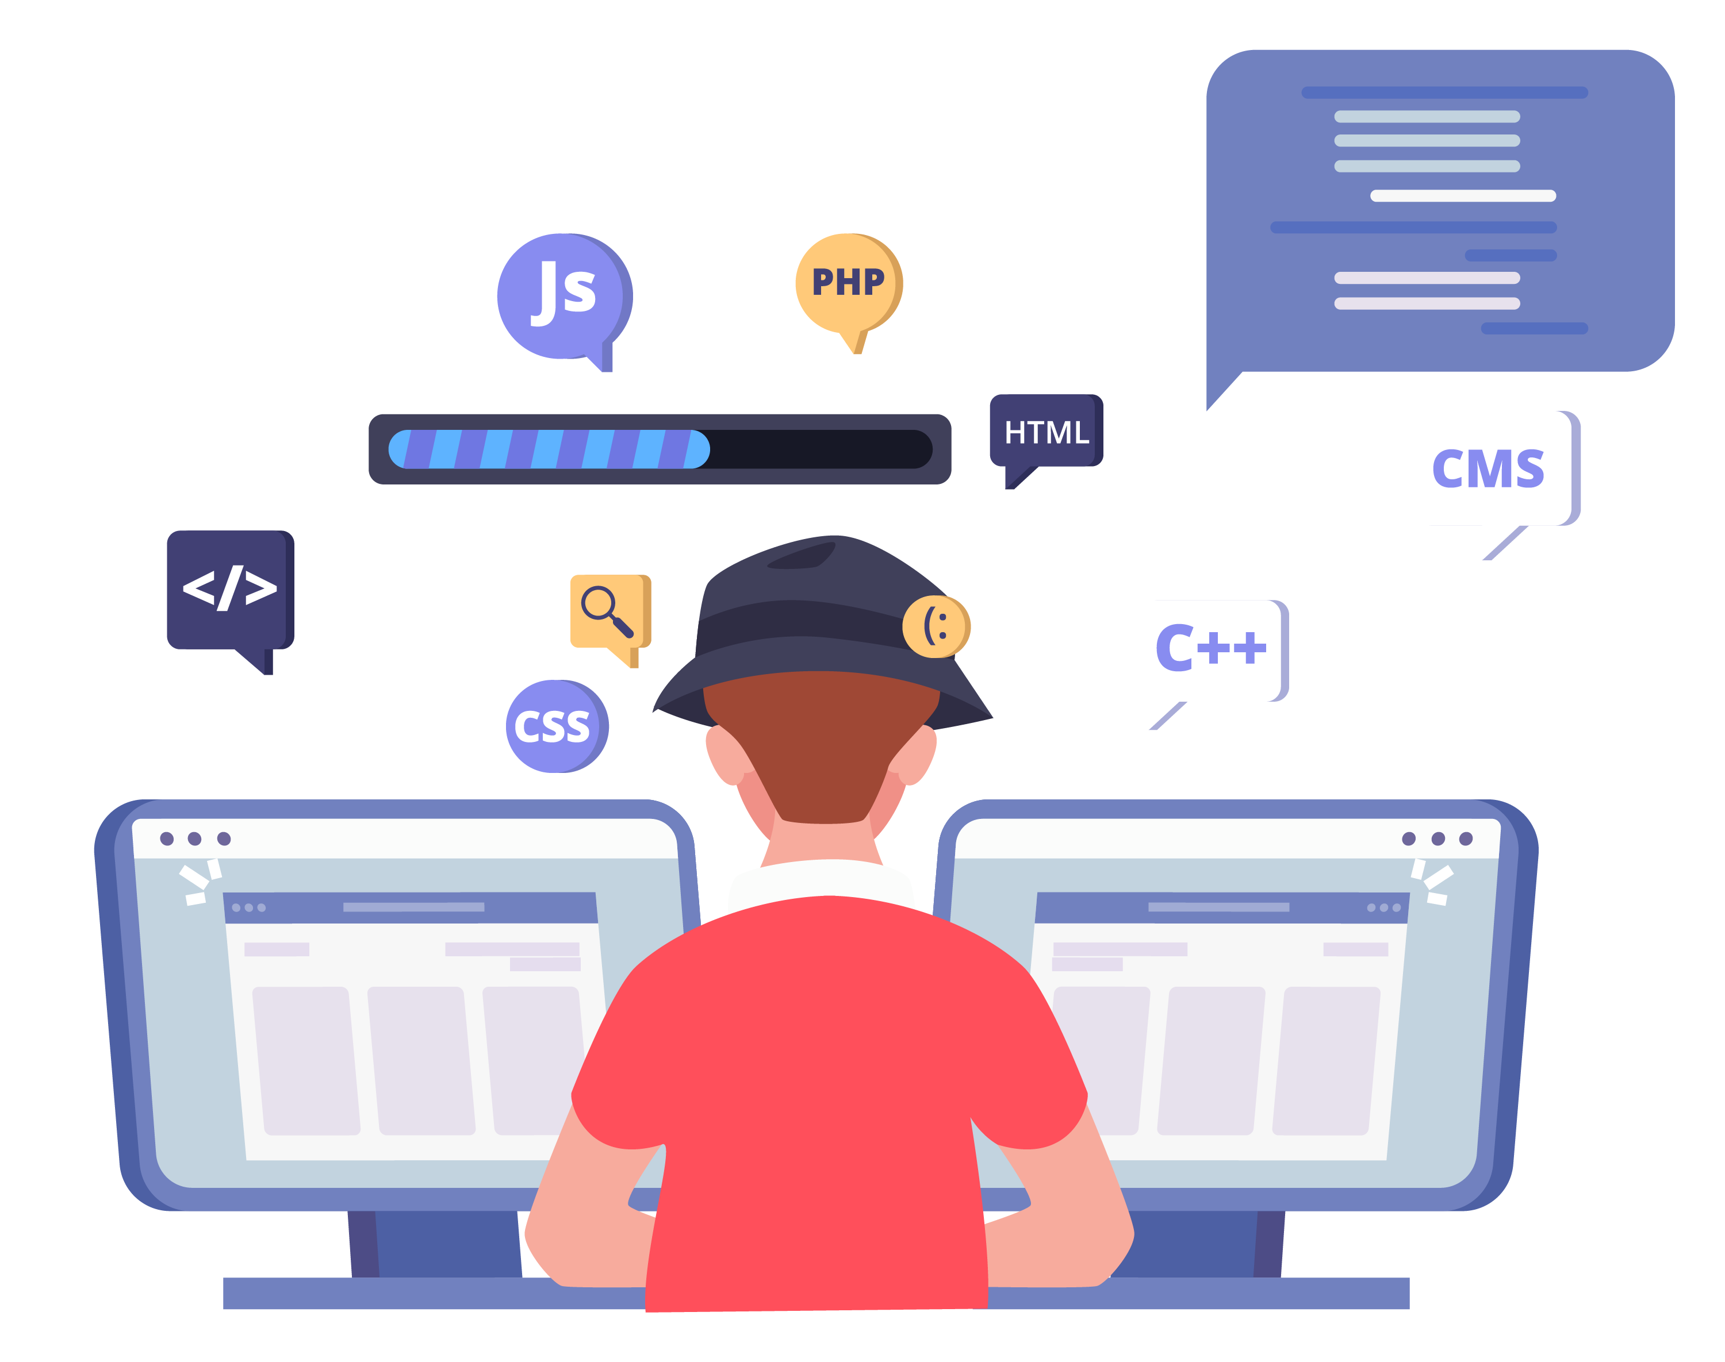

3. Key Findings: Root Cause Analysis
System/App developers usually analyze SUR logs by hand
We develop a semi-automatic two-phase analysis pipeline
The first phase classifies SUR events with the same root cause to a cluster, and the second phase pinpoints the root cause
Provide
Insights
Upload Logs
Reproduce & Analyze
......
......
Online Macro Statistical Analysis
Offline Micro Reproduction Analysis
Notes:
So what’s the root cause of these phenomenon?
To answer this question, we devise an efficient and scalable two-phase analysis pipeline over the enormous collected data.
First, we perform a macro-level analysis to classify similar SUR events to the same root cause cluster and further reproduce them in offline micro analysis to pinpoint the root causes.

Slide 12
3. Key Findings: Root Causes Analysis
Phase 1: Online Macro-level Statistical Analysis
Clustering results: long CPU scheduling delay (20.98%), slow I/O transactions (11.32%), insufficient memory (26.70%), and app-specific defects (41%)
Phase 2: Offline Micro-level Reproduction Analysis
Define the time window around an SUR event (±1s)
Quantitatively assess the correlation between the occurrence time of SUR events and the lifespan of low-priority processes (> 0.91)
Key insight: The persistent survival of numerous low-priority processes of hogging apps leads to system resource under-provisioning and contention, and thus causes SUR events
Notes:
With the above analysis pipeline, we locate four major preliminary causes.
They are long CPU scheduling delay, slow I/O transactions, insufficient memory, and app-specific defects.
Through our offline micro-level analysis and reproduction, we find these resource under-provisioning and contention are cause by the persistent survival of numerous low-priority processes of some apps.
We call these apps as hogging apps.

Slide 13
3. Key Findings: Hogging Apps
Major Keep-Alive Patterns
Commercial Motivations
Abuse foreground services (e.g., GPS, Audio, Bluetooth, and Network) to deliberately increase their processes’ priorities
Conduct dual-process co-awakening via process binding
User retention & engagement: escalate user retention and engagement rates, and thus potentially boost the revenue
In-app advertisements: continually display ads or push notifications to users, thereby generating revenue
Data harvesting: continuously collect user data
Cross-app awakening: leverage the sustained presence to promote or awaken other apps from the same developer or affiliated partners
Notes:
For hogging apps, we identify two patterns for keeping their processes alive in the background, namely abusing foreground services and conducting dual-process co-awakening behaviors through process binding.
It is easy to understand why hogging apps strive to keeping their processes alive.
Increasing the running time can finally increase their revenue.

Slide 14
4. Rethinking Process Management
Manage the lifecycle of each app process
Decide which process(es) should be kept alive or killed when system resources become constrained
Priority: Foreground > Visible > Service > Background > Empty
The state machine that models the process management in Android
Over-optimistic Assumption
Real-world Scenario
Process State Transition
Is Deterministic
State Transition Should Consider Processes’ Actual Behaviors
Notes:
To well manage these hogging apps and therefore reduce SUR events, we rearchitect the Android Process Management Model.
The Android Process Management Model manages the lifecycle of each app process, and decides which processes should be kept alive or killed when system resources are constrained.
It divides the process into five states, each of which has a specific priority.
The transitions of different process states can be regarded as a state machine.
The key problem here is that current Android Process Management has an over optimistic assumption that the process state transition is deterministic.
However, as you can see, in the real-world scenario, stat transitions should consider processes’ actual behaviors as today’s hogging apps take various measures to keep their processes alive in the background.
These behaviors currently cannot be sensed by Android.

Slide 15
4. Remodeling Process Management
TIHMM-based Process State Modeling
eBPF-based Uniform Authentic Sensing
Add new hidden states (“hogging” ) to the original state machine
Formalize the process transition as a Time-inhomogeneous Hidden Markov Model (TIHMM) transition in a time-sensitive manner
Leverage eBPF to sense the real usage of user-perceptible foreground services as observations, by attaching probes to the corresponding codes across kernel and framework
Notes:
To address this, our key insight is that the state changes during the lifecycle of the process can be deemed as a time series.
We add new hidden states that needs to be monitored to the original state machine, which we call hogging states.
After that, we leverage the time-inhomogeneous Hidden Markov model (TIHMM) to describe the real-world process states and their dynamic state transitions.
We also devise a uniform authentic sensing layer in Android to capture the hardware states to inform our Markov model.
With the above efforts, we can identify and constrain low-priority hogging apps to avoid system resource under-provisioning and contention.

Slide 16
4. Real-world Deployment & Evaluation
Patched our proposed mechanism to Android-MOD
Invited the original 47M users to upgrade (60% opted in)
The evaluation spanned two months (Jan.–Feb. 2023)
Reduce the prevalence of SUR events by 50%
Reduce the frequency of SUR events by 60%
Reduce the battery consumption by 10.7% due to the effective throttling of resource usages from hogging apps
Notes:
The original 47 million users are invited to install the patch and about 60% of them opted in to test our solution.
Finally, our solution reduces the SUR events by 50 to 60%.

Slide 17
4. Android vs. iOS
With the similar hardware configuration, Android suffers far more (oftentimes 10X) SUR events than iOS according to our measurement
Hardware and software co-design of iPhones: iOS can be fine-tuned to work perfectly with the specific hardware it runs on
More stringent scrutiny policy: Apple's App Store has stricter guidelines and a more rigorous app review process than Google Play Store
SUR = Slow UI Responsiveness
Notes:
Of course, we also performed a small-scale measurement on iOS
We find that with the similar hardware configuration, iOS suffers far fewer SUR events than Android according to our measurement.
Such advantage can be attributed to the hardware and software co-design of iPhone and the more stringent scrutiny policy.

Slide 18
5. Summary of Contributions
Conduct the first large-scale measurement study on SUR (Slow UI Responsiveness) events for Android in the wild with the generous help from 47 million Xiaomi users; share our continuous monitoring infrastructure for capturing SUR events on user devices
Present our semi-automatic analysis pipeline for deeply understanding SUR events; pinpoint the largest root cause of SUR to be the system-wise resource contention caused by the wide existence of hogging apps
Remodel Android process management to effectively detect & suppress hogging apps; real-world deployment reduces the occurrence of SUR events by 60% and saves the battery consumption by 10.7%
Code and data released at https://Android-SUR.github.io
Thanks!
Q & A
Notes:
To conclude this talk, I summarize our major contributions here.
Conduct the first large-scale measurement study on SUR and share our continuous monitoring infrastructure for capturing SUR.
We present our semi-automatic analysis pipeline for deeply understanding SUR and pinpoint the largest root cause of SUR to be the system-wise resource contention caused by the wide existence of hogging apps.
We remodel the Android process management to detect & suppress hogging apps. Real-world deployments show its effectiveness.
Thank you.

Slide 19
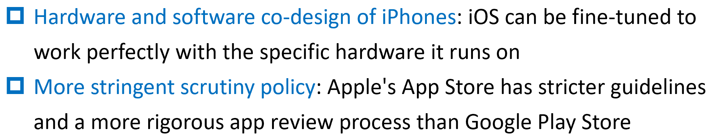

4. Innovation of Our Solution
Due to the decentralized nature of the Android ecosystem, Apple App Store’s early detection approach is not suited to Android for addressing hogging apps
Instead, we attempt to tackle SUR events at a different stage (i.e., during an app’s run time) from a novel perspective (i.e., inspecting the internal mechanism of Android)
Not limited to pure system-wise solutions, we also collaborate with app developers to address app-specific SUR issues
Notes:
To ensure the sufficient supply of system resource, the Android Process Management Model manages the lifecycle of each app process in a hierarchical manner, deciding which processes should be kept alive or killed when system resources are constrained.
The priority hierarchy of processes is as follows: Foreground, Visible, Service, Background, and Empty.
Given the deceptive behaviors of hogging apps for keeping alive,
the existing optimistic process management model fails to effectively manage the real-world Android processes due to its deterministic state transitions and the incapability of sensing the actual behaviors of processes.

Slide 20
More Details
Avoided 70.11% of frame drops per device per day (the frame drop rate decreased from 7.97% to 2.25%)
Reduced the energy consumption of the entire device by an average of 10.69% per day due to the effective throttling of resource usages from hogging apps
The false positive rate and false negative rate of identifying hogging apps are 0.08% and 0.13%, respectively, both of which are very low. (We allow users to report these apps for our manual examination.)
Notes:
Also, our solution avoids 70.11% of frame drops per device per day.
Moreover, due to the effective throttling of resource usages from hogging apps, the energy consumption has been reduced by an average of 10.69% for each device model.
Validations show that both of the false positive rate and false negative rate of identifying hogging apps are very low.

